Slide 1
Computer Networks

Slide 2
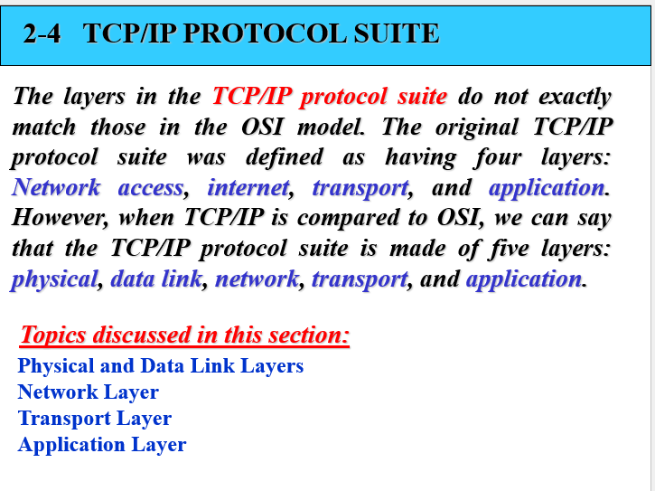

Slide 3
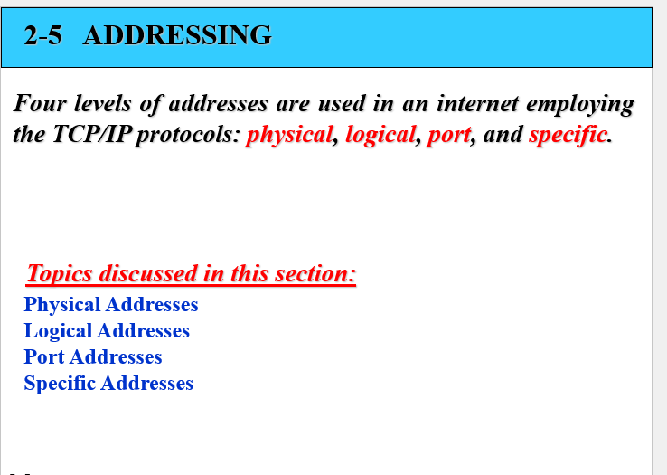
Addressing in Tcp/Ip suit
Addressing in networking refers to the process of assigning unique identifiers to network devices, enabling them to communicate with each other within a network.

Slide 4
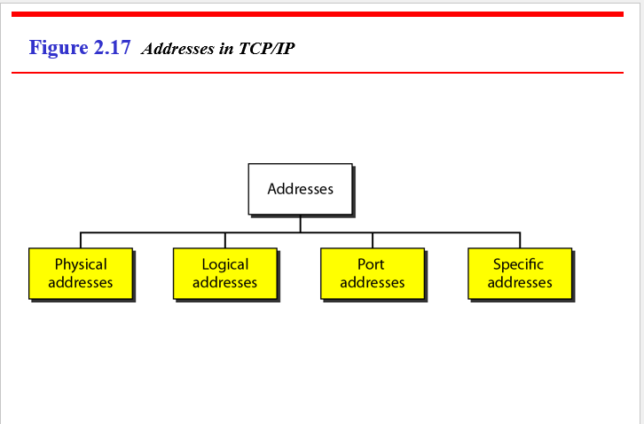

Slide 5
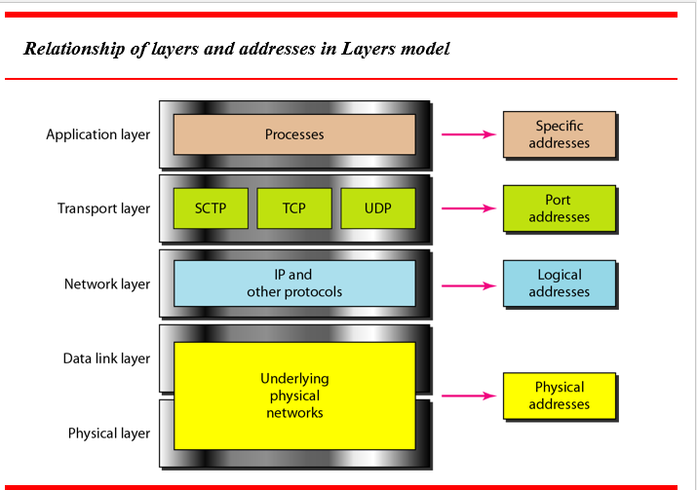

Slide 6
Physical/ MAC address
Physical addressing, also known as MAC (Media Access Control) addressing, is a fundamental aspect of networking that occurs at the dat
Purpose:
Physical addressing is used to uniquely identify network devices at the hardware level within a local area network (LAN).
It enables devices to communicate with each other over the network by providing a way to address data frames directly to specific devices.
MAC addresses are used by network protocols, such as Ethernet, to control access to the network medium and ensure that data is transmitted to the correct destination.
a link layer and physical layers of the OSI model.

Slide 7
Conti..
Size:
MAC addresses are typically 48 bits or 6 bytes in length.
They are represented in hexadecimal notation, with each byte separated by colons or hyphens (e.g., 00:1A:2B:3C:4D:5E).
The first half of the MAC address (the first 24 bits) usually represents the manufacturer identifier (OUI - Organizationally Unique Identifier), while the second half (the last 24 bits) is the unique identifier assigned to the network interface by the manufacturer.

Slide 8
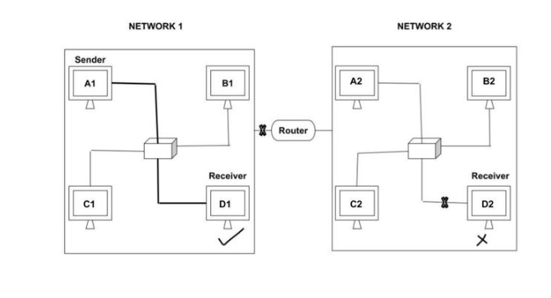
Conti…

Slide 9
Logical/ IP address
Logical addressing, also known as IP (Internet Protocol) addressing, is a key component of networking, operating at the network layer of the OSI model.
Purpose:
IP addressing is used to uniquely identify devices on a network and enable communication between them across interconnected networks.
It provides a logical addressing scheme that facilitates routing of data packets between source and destination devices regardless of their physical locations.
IP addresses play a critical role in packet forwarding, routing, and network management within the TCP/IP protocol suite.

Slide 10
Logical/ IP address
Size:
IPv4 addresses, the most commonly used version of IP addressing, are 32 bits in length.
IPv6 addresses, the newer version designed to address the limitations of IPv4, are 128 bits in length.
IPv4 addresses are typically represented in dotted-decimal notation (e.g., 192.168.1.1), where each octet (8 bits) is separated by periods.
IPv6 addresses are represented in hexadecimal notation, with colons separating each group of 16 bits (e.g., 2001:0db8:85a3:0000:0000:8a2e:0370:7334).

Slide 11
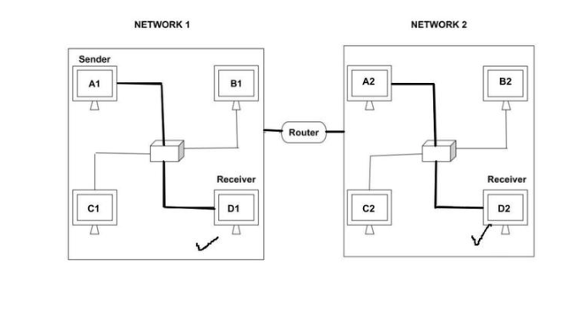
Conti…

Slide 12
Port addressing (for process to process communication)
Port addressing is a crucial aspect of networking, particularly at the transport layer (Layer 4) of the OSI model.
Purpose:
Port addressing is used to differentiate between multiple network services or applications running on the same device.
It allows a single device to host multiple network services simultaneously, each identified by a unique port number.
Port addressing enables communication between applications or services on different devices by specifying both the destination IP address and port number in network communication.

Slide 13
Port Addressing
Size:
Port numbers are represented as 16-bit unsigned integers, allowing for a range of values from 0 to 65535.
Well-known ports are reserved for specific services and applications commonly used on the internet, such as HTTP (port 80), HTTPS (port 443), FTP (port 21), SSH (port 22), and SMTP (port 25).
Registered ports (1024-49151) are assigned by the Internet Assigned Numbers Authority (IANA) to specific services and protocols.
Dynamic or ephemeral ports (49152-65535) are used for temporary communication between client and server applications.

Slide 14
Types
Three types of port addresses:
Ranges
Well known ports 0-1023
Registered ports 1024-49151
Dynamic/Private ports 49152-65535

Slide 15
Specific addresses
Application-Specific Addresses Some applications have user-friendly addresses that are designed for that specific application. Examples include the e-mail address (for example, co_sci@yahoo.com) and the Universal Resource Locator (URL) (for example, www.mhhe.com). The first defines the recipient of an e-mail; the second is used to find a document on the World Wide Web. These addresses, however, get changed to the corresponding port and logical addresses by the sending computer
Examples
URL address
Email address

